Slide 1
Summary, Insights and Visualizations

Slide 2
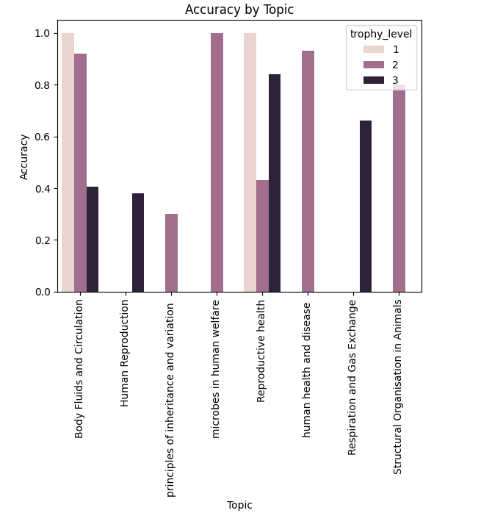

Slide 3
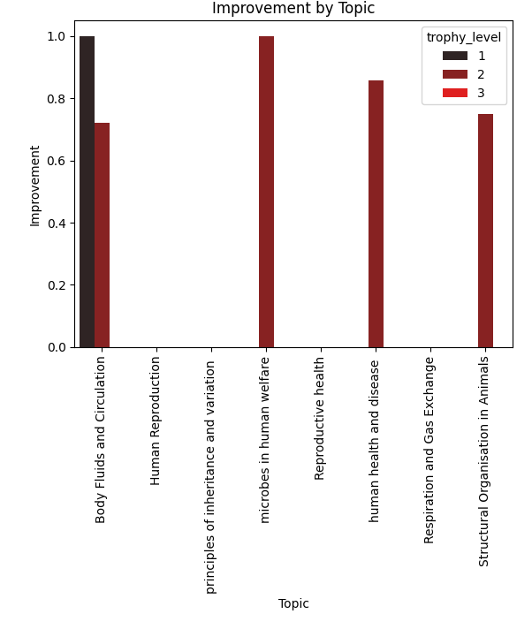
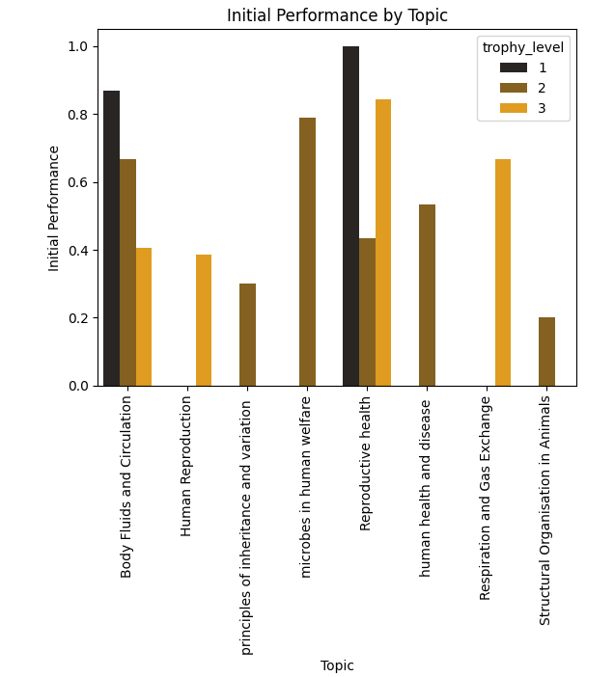

Slide 4
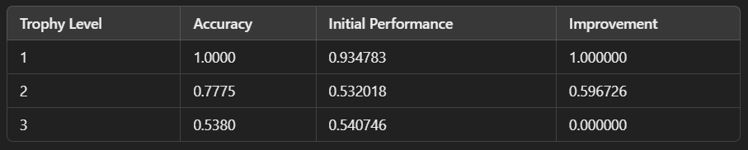
Average Performance by Trophy level
Trophy Level 1 demonstrates exceptional performance with 100% accuracy, 93.48% initial performance, and 100% improvement. No immediate focus is required here.
Trophy Level 2 shows moderate performance with 77.75% accuracy, 53.20% initial performance, and 59.67% improvement. There is significant potential for enhancement at this level.
Trophy Level 3 reveals weak performance with 53.80% accuracy, 54.07% initial performance, and no improvement observed. Focus here only after improving at Trophy Level 2.
Recommendation: Emphasize improving performance at Trophy Level 2 before progressing to Trophy Level 3.

Slide 5
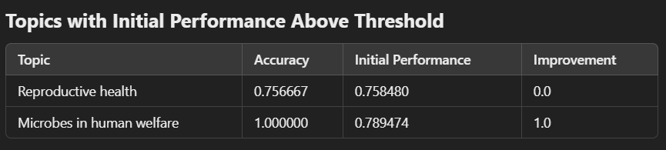
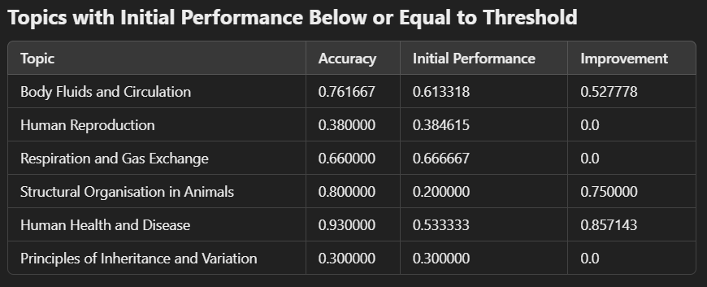
Average Performance by Topic
Reproductive Health: Strong initial performance (Accuracy: 75.67%, Initial Performance: 75.85%) but no improvement. Focus on Trophy Level 2 quizzes for further refinement.
Microbes in Human Welfare: Exceptional performance (Accuracy: 100%, Initial Performance: 78.95%, Improvement: 100%). No further focus required.
Human Reproduction: Weak performance (Accuracy: 38%, Initial Performance: 38.46%, Improvement: 0%). Prioritize Trophy Level 1 quizzes to build foundational knowledge.
Respiration and Gas Exchange & Structural Organization in Animals: Moderate performance; improvement is limited. Recommend Trophy Level 2 quizzes to strengthen understanding.
Body Fluids and Circulation: Good overall performance (Accuracy: 76.17%, Initial Performance: 61.33%, Improvement: 52.78%). Progress to Trophy Level 3 quizzes.
Human Health and Disease: Excellent improvement (Accuracy: 93%, Initial Performance: 53.33%, Improvement: 85.71%). Advance to Trophy Level 3 quizzes.

Slide 6
Actionable Recommendations
Focus Areas:
Strengthen weak topics like Human Reproduction and Principles of Inheritance and Variation with Trophy Level 1 quizzes.
For topics like Respiration and Gas Exchange and Structural Organisation in Animals, focus on Trophy Level 2 quizzes to leverage improvement potential.
Progression:
For strong topics such as Body Fluids and Circulation and Human Health and Disease, advance to Trophy Level 3 quizzes to master advanced concepts.
General Focus:
Prioritize improving performance at Trophy Level 2 before intensively tackling Trophy Level 3 to ensure a robust foundation.

